Slide 1

Professional Spam Filtering at Open Source Prices
Benjamin Schmaus
O’Reilly Open Source Convention
July 26–30, 2004

Slide 2

Agenda
Spam and its effects
Dealing with spam
Open source spam filtering projects
Commercial equivalency
Bleach
Summary

Slide 3
What is Spam
Unsolicited bulk email
Email you did not want or ask for
Mailing lists & newsletters not included

Slide 4
Spam Concerns
Decreases productivity
Increases operational costs
Wastes resources
Could be a liability
Obnoxious

Slide 5
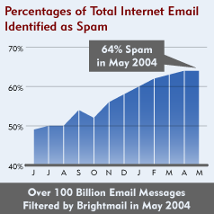
What to do about Spam?
Nothing
Stop using email
Accept some domains
Filter

Slide 6
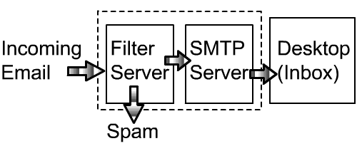
How Filtering Works
SMTP Proxy
Local Desktop

Slide 7
Filtering Options
Commercial options
  Can-It
  Brightmail
  Messagelabs
  Mcaffee Spamkiller
Open source options
  MIMEDefang
  Spamassassin
  Procmail
  DCC
  DSPAM

Slide 8
Open Source Solutions
MIMEDefang
Procmail
Spamassassin
DCC
DSPAM

Slide 9
MIMEDefang
Interfaces with Sendmail’s API (milter)
Written in Perl for easy text manipulation
Access to many CPAN modules
Provides access to create filtering policies

Slide 10
Procmail
Easy to customize rules per recipient
Known tested and documented
Inefficient
Cannot be used as a SMTP proxy
Requires constant update of rules

Slide 11
Spamassassin
Uses rules for heuristic testing
Tests against headers and body
Custom rules
Bayesian filtering
Can use DCC, Pyzor or Razor2

Slide 12
DCC
Calculates “fuzzy” checksum on email
Checks to see if bulk email
Lengthy standalone install procedure
No gui/web interface

Slide 13
DSPAM
Statistical hybrid filter
High level of accuracy
Web interface
No virus protection

Slide 14
Commercially Equivalent?
Easy to install?
Easy to configure?
Easy to manage?
Is the filter effective?

Slide 15
Bleach the Open Source Way
Proof of concept
Provides a web interface
Provides a collection of filtering tools
Uses the text processing power of Perl
Based on open source applications
Easy to use and manage

Slide 16
Bleach Features
Variety of filtering tests & capabilities
Web based configuration
Web based quarantine
User based settings
Database driven
Scans for viruses

Slide 17
Bleach Components
Mimedefang
Spamassassin
DCC
MySQL
Apache
Perl w/ modules from CPAN
Custom Web Interface

Slide 18
How Bleach Filters
Uses MIMEDefang to access milter
Custom filter selects config from database
Filter scans for viruses
Custom filter calls Spamassassin
Spamassassin initiates DCC checking
Spam details stored in database

Slide 19
Bleach Interface
Login
Statistics
Configuration
Quarantine
View
Forward

Slide 20
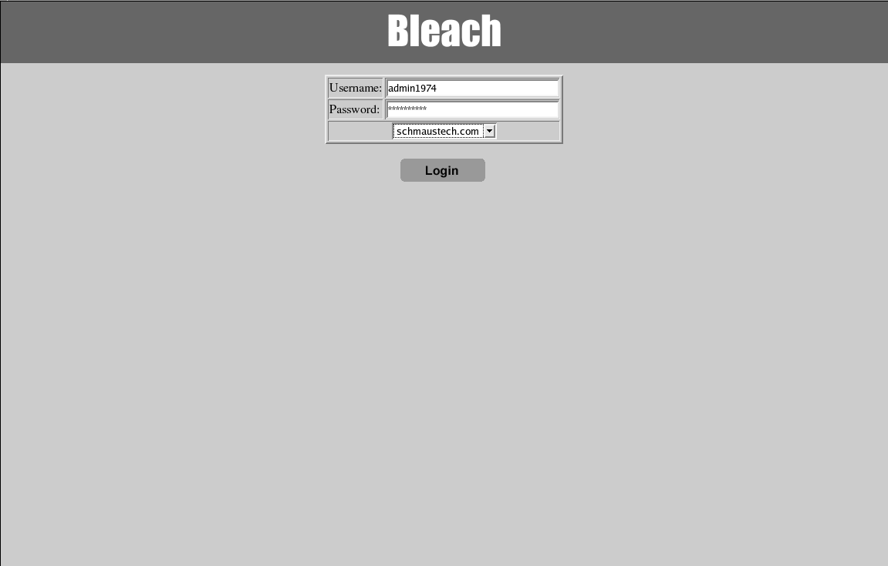
Bleach Login

Slide 21
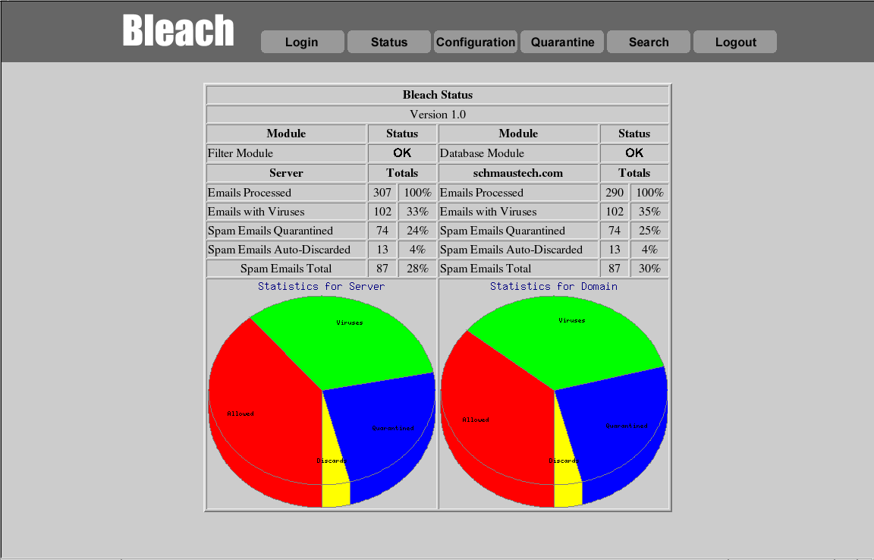
Bleach Statistics

Slide 22
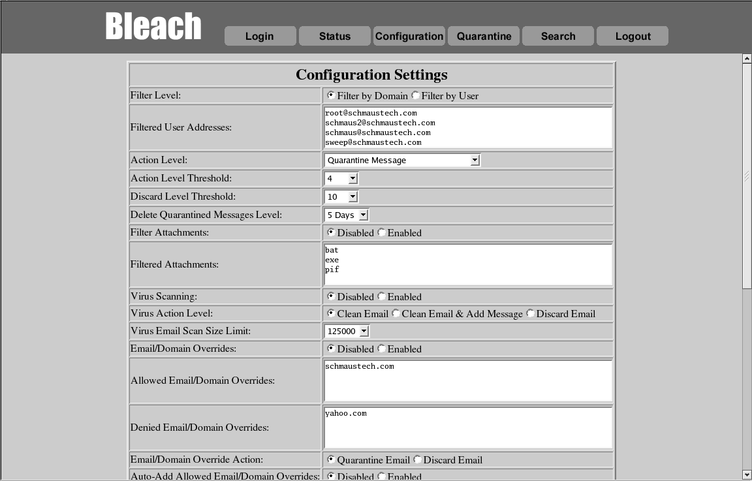
Bleach Configuration

Slide 23
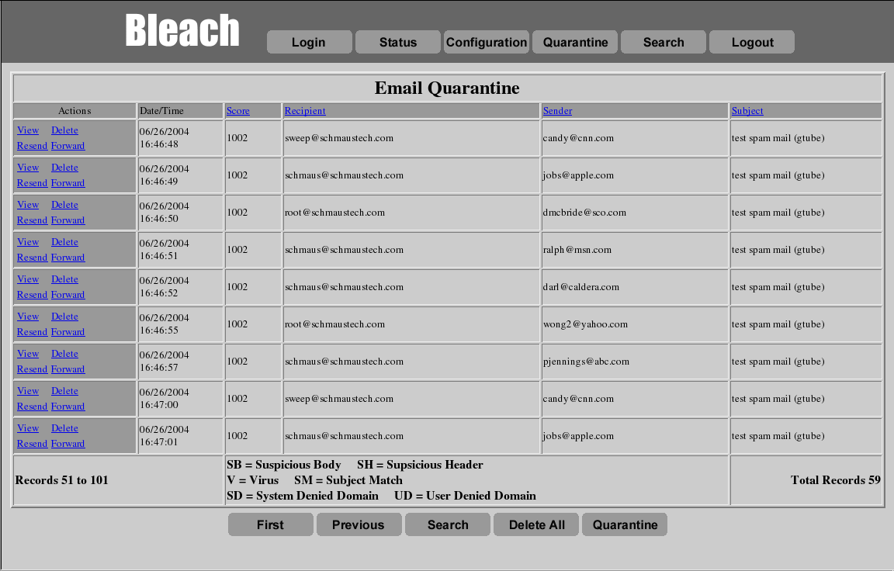
Bleach Quarantine

Slide 24
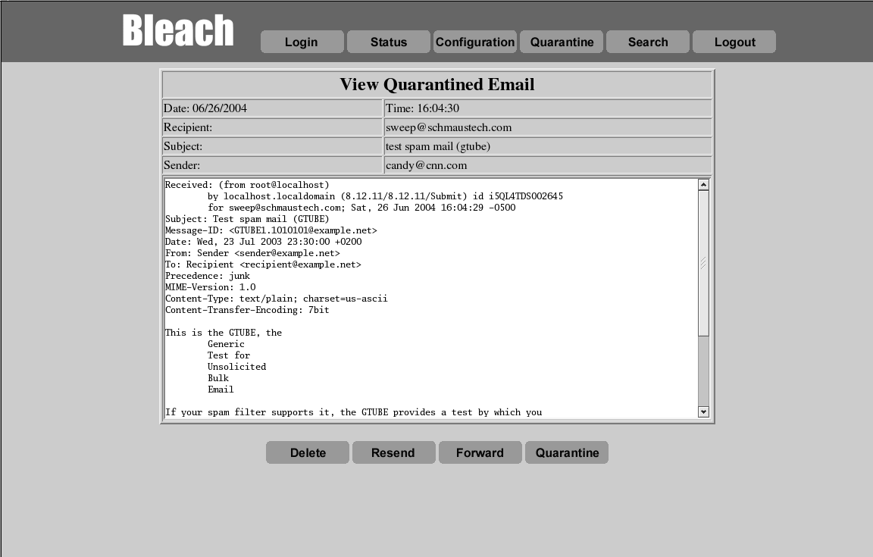
Bleach View

Slide 25
Future of Bleach
Possible addition of DSPAM
Web based install
More features
Port to PHP

Slide 26
Summary
Spam is a growing problem
Many free tools to fight spam
Build commercial equivalents
Use Bleach
Build your own
Thank You!

Slide 27


